Slide 1
Commercial Card
Expense Reporting (CCER)
The Trustees of Roanoke College
An internet solution
Accessed via Wells Fargo’s secure Commercial Electronic Office® (CEO) portal

Slide 2
Commercial Card Expense Reporting (CCER)
What is it?
CCER is an internet reporting solution that allows on-line access to your card transactions at any time, from any location. It is accessed via Wells Fargo’s secure Commercial Electronic Office® (CEO®) portal.
Cardholders can:
Review/reclassify transactions
Input a business description for all transactions
Split transactions
Approvers can:
Review/approve cardholder statements
View statement summary reports

Slide 3
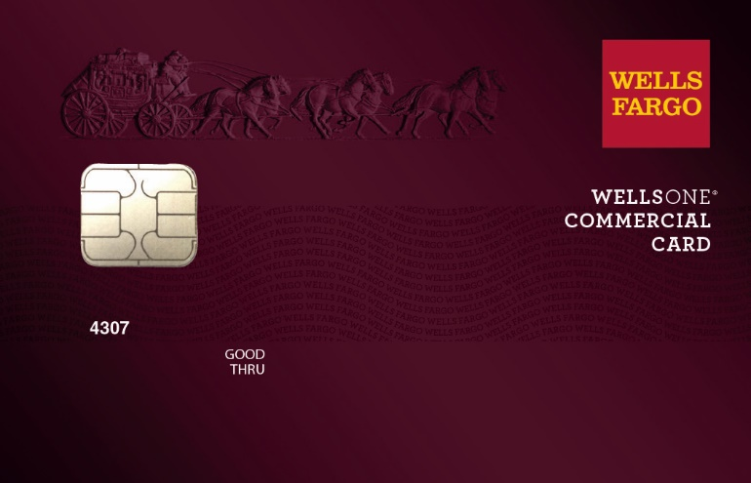
To get started
After receiving your card…
Activate your card by calling the toll free number located on the activation sticker
During activation you will need your Unique Identification Number (ID) - if you do not know your Unique ID, please contact your internal Program Administrator to obtain
During activation you will be asked to create a customized Personal Identification Number (PIN)
Sign the back of your card
Record the Wells Fargo Customer Service number (1-800-932-0036) located on the back of your card in your mobile device, or address book
Sign on to the CEO and initialize your CEO User ID

Slide 4
Chip and PIN Card Information
To enhance the security of your credit card purchases, your new commercial card features chip and personal identification number (PIN) technology, in addition to a magnetic stripe. With this card, you will have added identity verification and more flexibility at chip-enabled and traditional magnetic stripe terminals. Please review the important information below to help you get started with your new card.
About chip-enabled cards
  Over the next year, U.S. merchants will begin using terminals that accept chip-enabled credit cards. Until then, you may use your card by swiping at the point of sale, just as you do today.
  As chip-enabled terminals are already being used internationally, you may use your card to complete chip-enabled transactions in Europe, Asia, South America, and Canada.
Getting started with your new card
To activate your card, you will need your unique identification (ID) number. If you do not know your unique ID, please contact your program administrator.
Activate your new card immediately by calling 1-800-932-0036, 24 hours a day, 7 days a week.
  When dialing from outside the U.S. or Canada, dial 001-800-932-0036. This is not a toll-free number when calling internationally.
  If you need help internationally, please call customer service collect at 1-612-332-2224.
When you activate your card, you will select a personal identification number (PIN). Use this PIN for chip-enabled transactions when prompted by the terminal. This same PIN will be used for cash advances, if you are authorized to make them. Depending on the terminal set-up, you may be prompted to provide your signature instead of your PIN. Once activated, the card is ready for use at either mag stripe terminals or chip enabled terminals.
If you forget or need to change your PIN, call the WellsOne Service Center at 1-800-932-0036, option 2, option 1.2.

Slide 5
New User Sign On
Sequence of steps
Sign on to the Commercial Electronic Office® (CEO®) using your temporary password
Change your password
Set up your secret questions
Read and accept the CEO Terms of Use
Confirm your profile information
Notes:
If you will be using an RSA SecurID® token device, we'll cover that topic after the first-time sign-on steps.
We'll begin with how to access the CEO portal itself…

Slide 6
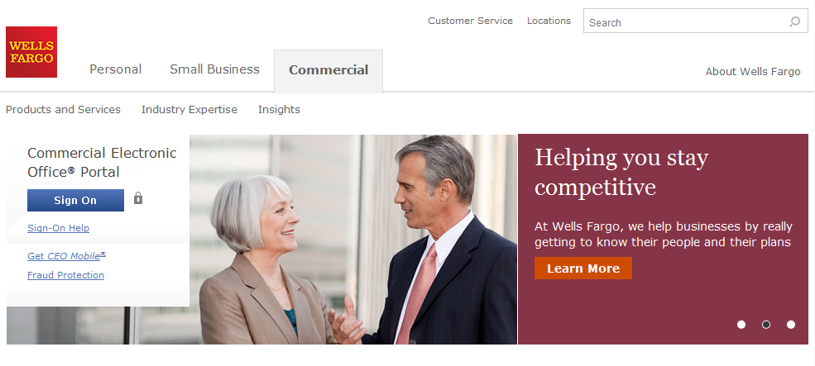
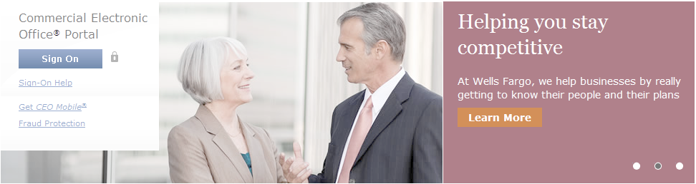
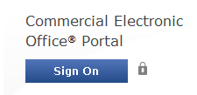
Wells Fargo home page wellsfargo.com

Slide 7
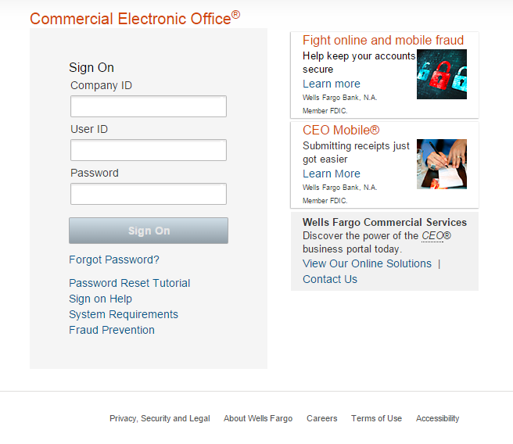
CEO portal sign-on website https://wellsoffice.wellsfargo.com
Enter your:
Company ID
  TRUST898
User ID
  Unique to user
Password
  Unique to User
Company ID, User ID and Password
are not case sensitive
To change or reset your password, click the Forgot Password? link.
If you incorrectly enter your password twice in the same session, you will automatically be taken to the Change Your Password page.

Slide 8
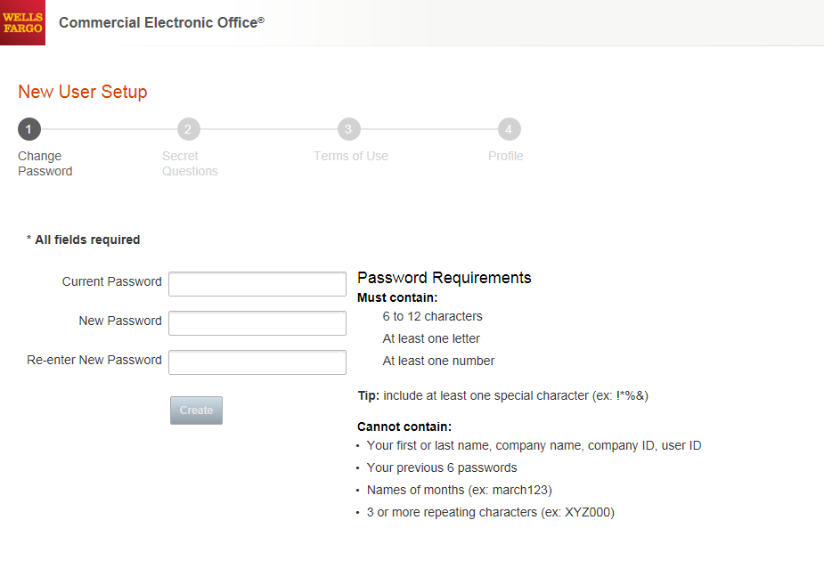
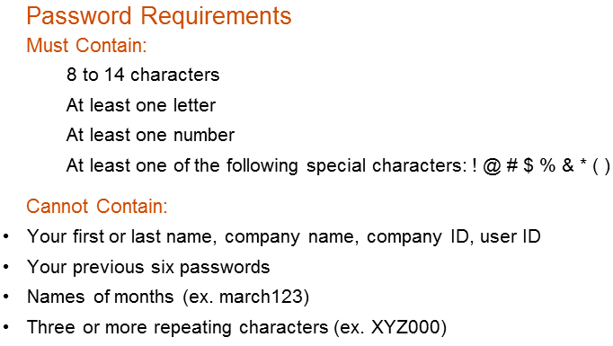

Change your password
●●●●●●●●●
●●●●●●●●
●●●●●●●●

Slide 9
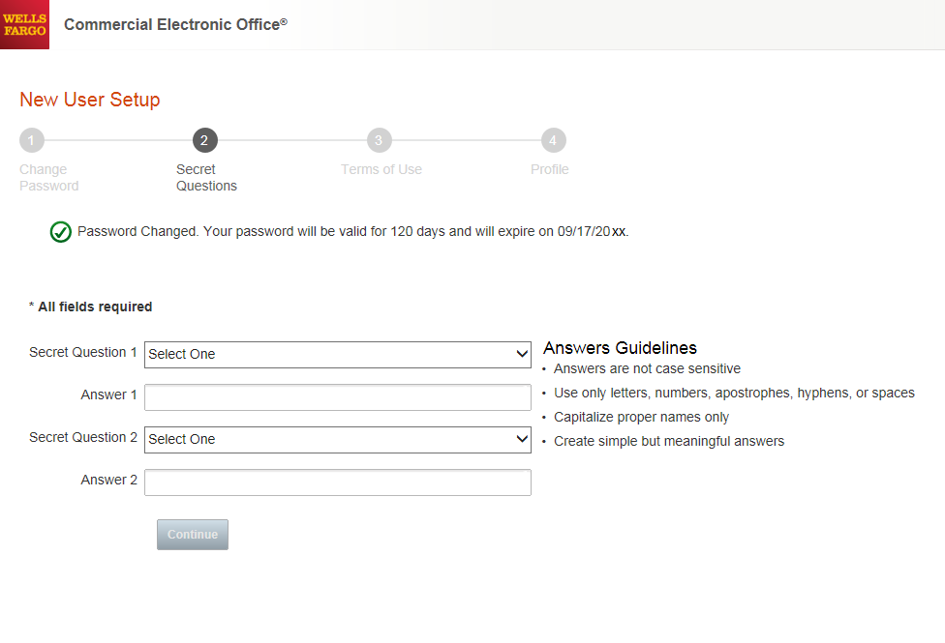
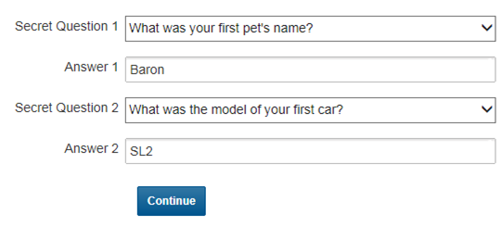
Set up your secret questions

Slide 10
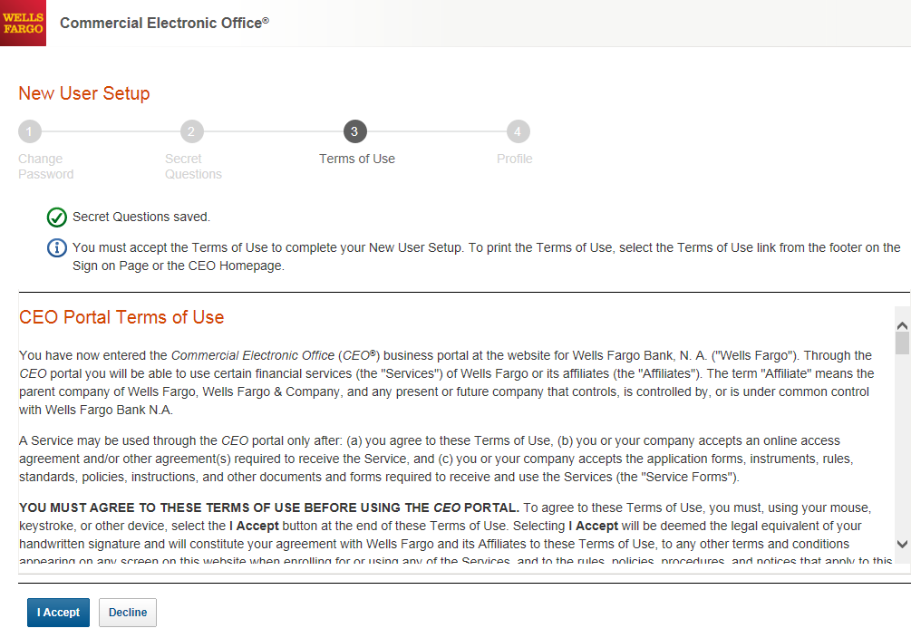
Read and accept the CEO Terms of Use

Slide 11
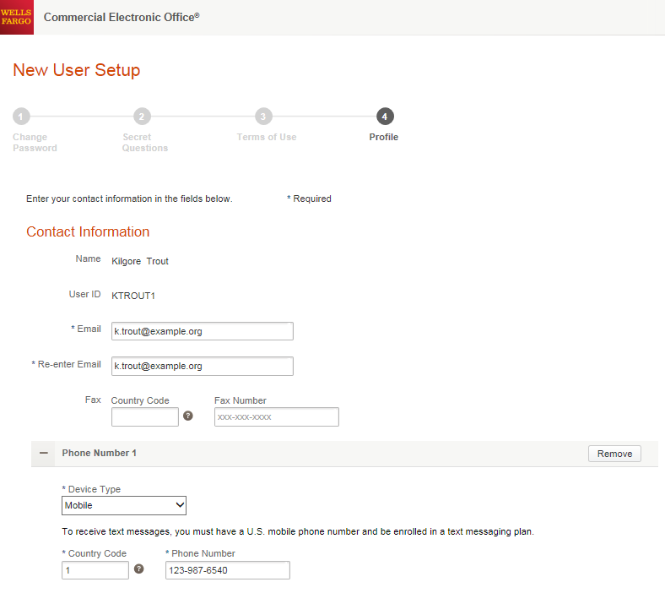
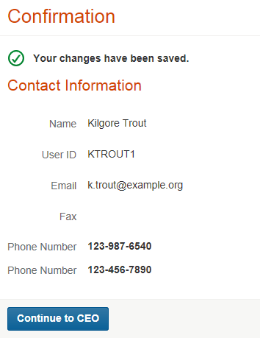


Confirm your profile Contact Information
Enter your email and phone information; Save, then Continue…

Slide 12
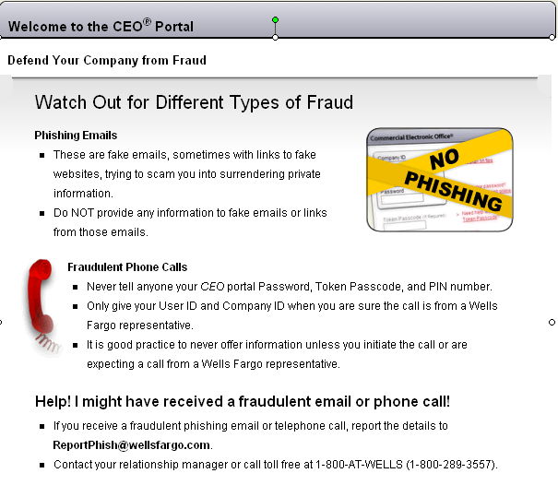

Slide 13
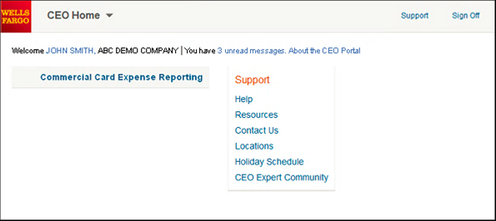
CEO home page
Click the link for Commercial Card Expense Reporting. A separate browser window opens and displays the CCER service
Click on Support to register for free online CEO product training
Click on Help for assistance and training
To automatically display CCER when you sign on to the CEO portal, click the link for your user name to set up Automatic Access
On the profile page, click the Edit link under Preferences
Set Automatic Access to the desired setting and click Save

Slide 14
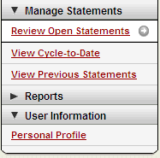
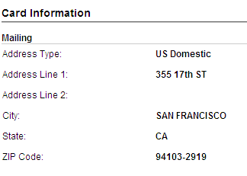
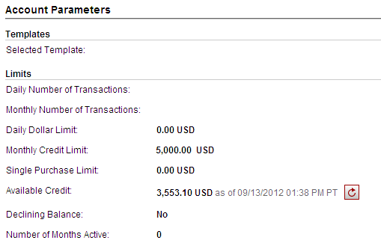
Personal profile
Click on link to Manage Alerts
Billing address for online and phone orders
You can also contact the
WellsOne Service Center 24/7 at
1-800-932-0036 to obtain available credit.
Must provide Unique ID to
obtain any information
Click to retrieve current available credit

Slide 15
3D Secure – Verified by Visa /
MasterCard SecureCode
What is 3-D Secure:
3-D Secure is the industry name for Verified by Visa and MasterCard SecureCode.
3-D Secure technology secures online transactions using an additional level of cardholder authentication.
With the introduction of Chip and PIN cards, fraud is increasingly moving online. International and now U.S. internet merchants are beginning to require 3-D Secure to complete transactions.
How it works:
  Cardholders must register their cards online prior to completing their purchase at a 3-D Secure enabled merchant.
  As part of the registration process, you will need to provide correct answers to 3 identity authentication questions. You will then create a personal passcode to be used for future purchases.
  Once enrolled, you will be prompted to input your personal passcode during the checkout process at 3-D Secure enabled merchants.
How to Enroll:
In order to enroll in this free, online security service, cardholders must:
  Register their card at:
  https://www.wellsfargo.com/com/fraud/payments_fraud/online-purchase-protection. During the registration process you will be asked to provide the last 4 digits of your Unique ID, your monthly credit limit, and the zip code tied to your card to verify your identity (all information may be found in your personal profile). Once this has been provided, you will create a personal passcode to be used when making online purchases with participating merchants.

Slide 16
Cardholder Responsibility
Collect receipts to verify purchases for auditing
Watch for unauthorized transactions on your statement and report/dispute them immediately
Dispute any incorrect charges with the vendor directly before filing an online or paper dispute form
Complete your reconciliation by the due date
Keep the card (and card number) confidential

Slide 17
Contact information
WellsOne Service Center - 1-800-932-0036
  From outside of the United States call 1-612-332-2224
  Call immediately if your card is lost, stolen or suspected missing
  For immediate decline information
  To access the automated voice response system for the following information:
    Current balance
    Available credit
    Reset PIN
Contact a program administrator if:
  You have questions about your card
  Need to increase your credit limit
  Change jobs
  Need to order cards for other employees
Program Administrators:
Kristen Douglas
Rachael Freeman
Rhonda Hibbitts
Adam Neal
Kathryn Vanness

Slide 18
Thank you!
© 2016 Wells Fargo Bank, N.A. All rights reserved. Confidential.

