Slide 1
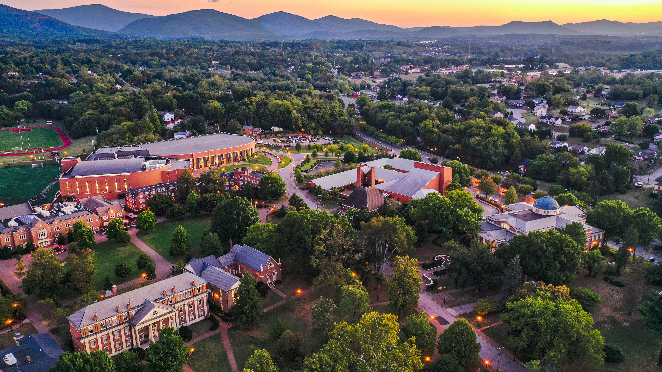

Slide 2
Template 6
Titles Avenir 54 pt.
TYPEFACE OCR STD 20PT OR CASCADIA CODE

