Slide 1
Engage and Educate with Tech Tools
Christine S. Stanley
Roanoke College
October 5, 2013
Session 72 9:00-10:00

Slide 2
Agenda for today:
What is Web 2.0?
Why use Web 2.0?
Web 2.0 applications that can be used in the world language classroom
Web 2.0 and you! Your future…..

Slide 3
What is Web 2.0?
Web 2.0 is the term given to describe a second generation of the World Wide Web that is focused on the ability for people to collaborate and share information online. Web 2.0 basically refers to the transition from static HTML Web pages to a more dynamic Web that is more organized and is based on serving web applications to users. Other improved functionality of Web 2.0 includes open communication with an emphasis on web-based communities of users, and more open sharing of information. Over time Web 2.0 has been used more as a marketing term than a computer-science-based term. Blogs, wikis, and web services are all seen as components of Web 2.0.
Source- Webopedia http://www.webopedia.com/
Notes:
Christine

Slide 4
Online in 60 Seconds

Slide 5
Technology can seem…
Word Cloud by
Notes:
Giuliana

Slide 6
21st Century Skills Core Skills
Collaboration
Creativity
Critical Thinking
Communication
Basic Knowledge->Applied Skills

Slide 7
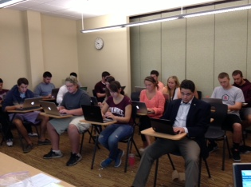
What is BYOD?
BYOD (BRING YOUR OWN DEVICE) is a phrase that has become widely adopted to refer to students who bring their own computing devices – such as smartphones, laptops and PDAs– to the school for use and connectivity on the school network
BYOD Contracts? Does your school system or institution have a BYOD policy?
Students at Roanoke College with their own devices taking a Quiz.

Slide 8
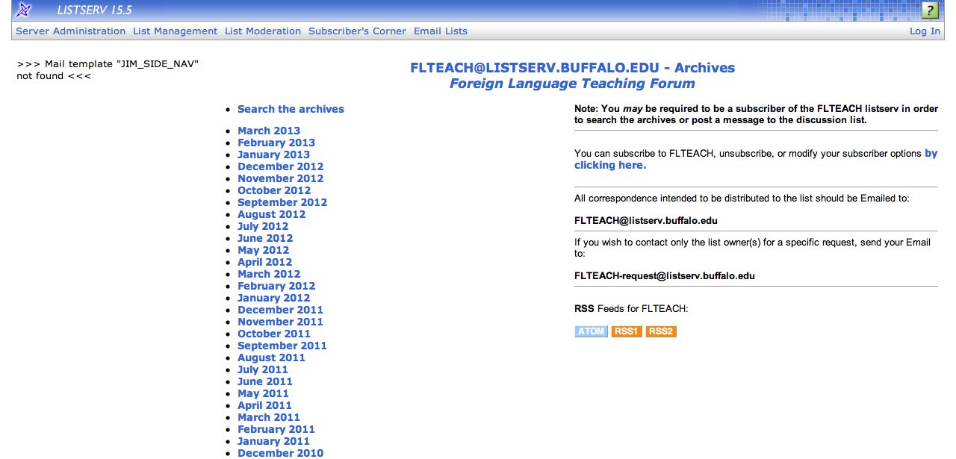
Starting with a plan
Lesson Plans made easy (an oldie but goodie)http://www.lex.vcu.edu/lesson_template/
Need some ideas to create an engaging lesson? Try using FLTEACH (listserv or archives). http://listserv.buffalo.edu/archives/flteach.html

Slide 9
Do your students have a plan? Why not?

Slide 10
Keeping students motivated to behave
What is discipline and why do we need it?
“Discipline” origin comes from Latin-dicere- to learn
If we have discipline in the classroom it makes for a situation that is more conducive to learning.

Slide 11
CLASS DOJO
Try Class Dojo for behavior management (all devices) http://www.classdojo.com
Students receive “Dojo” points for positive behavior (participation, helping others, great insight, hard work, presentation) or negative points for unwanted behaviors (no homework, interrupting, disrespectful, late, out of chair). You can customize your list of behaviors and generate an individual report for each student to collect overall performance data. Parents and/or students can have access to this information with a class code or it can be printed or emailed. The teacher can set a minimum number for points so that students know they have to be on task, prepared and participate daily.

Slide 12
Keep them on their toes with iLeap

Slide 13
Keep them on their toes…
http://www.superteachertools.com/instantclassroom/random-name-generator.php

Slide 14
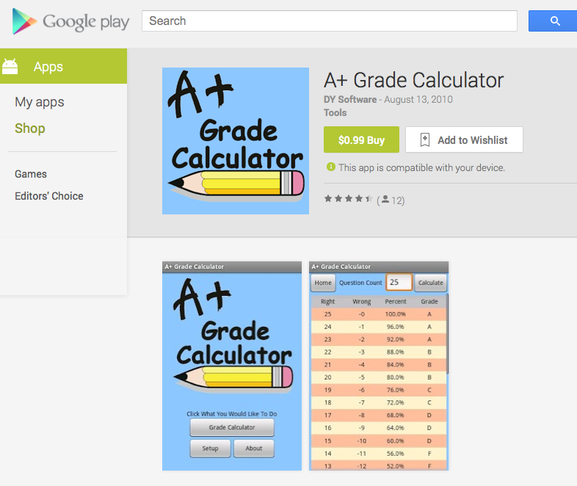
ALL THE GRADING…

Slide 15
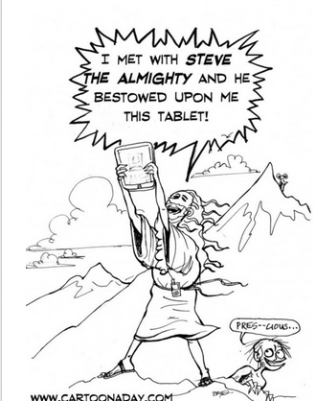
Apps that work…
What is an app? An app is simply an application that can be used on a computer, tablet, cellphone or an idevice (iphone, ipad, ipod touch).
There are a lot of apps that help students with language acquisition.
These apps were recommended to me by my former or current students.

Slide 16
Free apps that students like
Duolingo (Duolingo.com) Available on the computer or any mobile device.

Slide 17
Free apps that students like
Duolingo

Slide 18
Duolingo
If you haven’t tried out Duolingo yet you are missing out. The app is free and more portable than a textbook if you need some extra practice in a language. I love it because it provides relatively easy lessons in a vast array of topics. It’s also great because the vocabulary you are practicing is probably different from what you are learning at that time in class, so you can get a good refresher in things you have already learned or learn a few new words that are useful in the language. You go at your own pace, so you can use it even if you have five or ten minutes to spare. My favorite thing about Duolingo, though, is the constant change between reading, writing, listening, and even speaking in Spanish. I have only been using Duolingo for a couple of weeks but so far I’ve loved keeping my little green owl happy!
Caity Ashley, Freshman, Roanoke College

Slide 19
Free apps that students like
Mindsnacks (Apple Market)
)

Slide 20
Free apps that students like
Sock Puppets

Slide 21
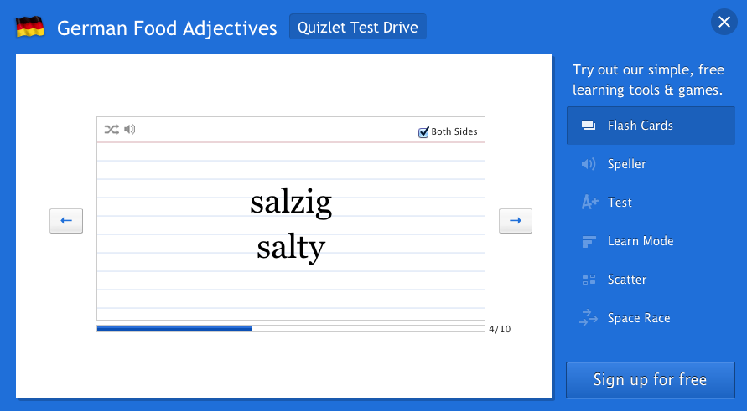
Free apps that students like
Quizlet.com (on all devices)

Slide 22
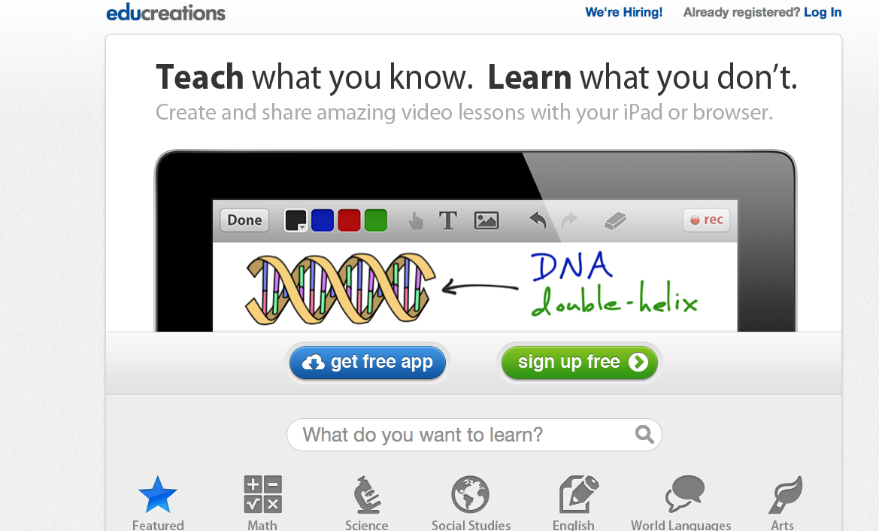
Free apps that students like
http://www.educreations.com/ (Any Device) Turn your screen into a virtual whiteboard.

Slide 23
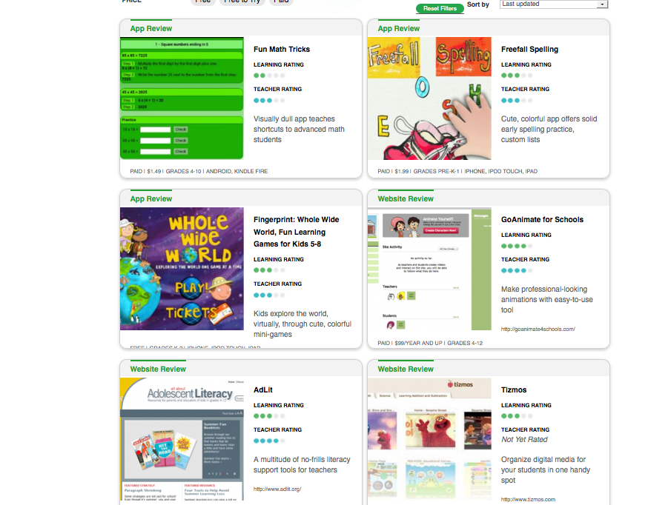
Finding and Evaluating Apps
http://www.graphite.org/
Find games, websites and apps that are rated by other educators. Maps to Common Core standards.

Slide 24
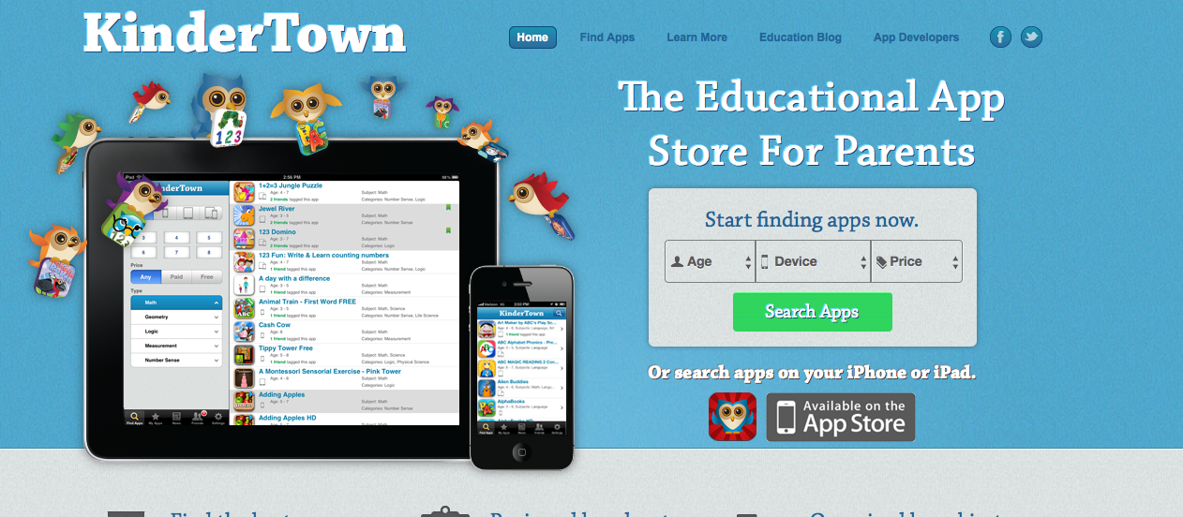
KinderTown
KinderTown http://www.kindertown.com/ This app searches over 600,000 educational apps. (Any Device)

Slide 25
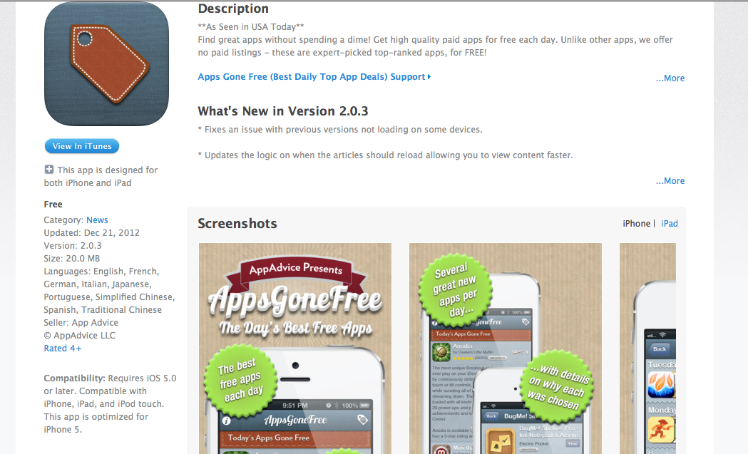
Free Apps!
AppsGoneFree (Market/Google Play)

Slide 26
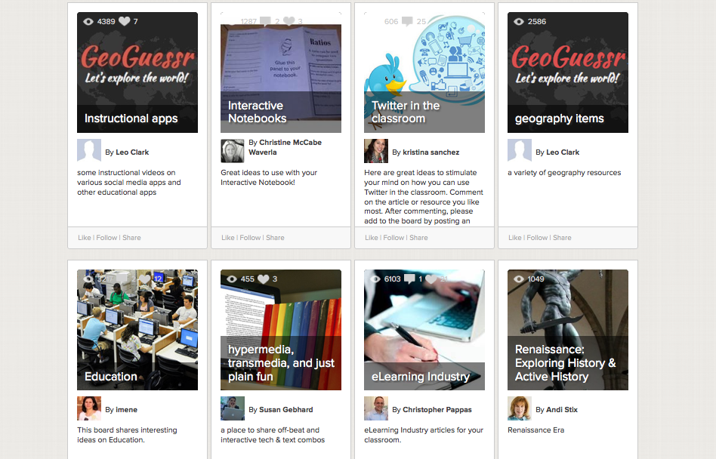
Learnist
http://learni.st/category/featured (Learnist)

Slide 27
Beeline TV
Beeline TV http://beelinetv.com/ Free TV from around the world.

Slide 28
Other apps and websites
Flipbook http://www.flipbook.tv/ Animation made easy
Flipsnack http://www.flipsnack.com/
Make interactive flip books
Plnnr http://plnnr.com/ Trip planning
EarthCam http://www.earthcam.com/ Real-time cameras around the world

Slide 29
More Apps
AutoRap (Google Play/Apple $) Be a rap star without having any talent at all!
Zondle www.zondle.com Game based learning
Flisti http://flisti.com/ (online polling)
The PolyGlot Project http://www.polyglotproject.com/

Slide 30
Cellphones
Remind101
This is a free service for teachers. Teachers can set up a maximum of 10 classes. Students (and parents) self-enroll into the class online. Texts can be sent to the entire class. Students will not have access to your personal cellphone number.
Notes:
Christine

Slide 31
Remind101
“I think that Remind101 is very useful for college students. On more than one occasion, this program has helped remind me of an assignment/test that I had completely forgotten about. I believe that only positive things would result from more widespread usage of Remind101 on college and high school campuses.”
Zack Lukado- Roanoke College
Kristen Sink’s thoughts on Remind 101 (Roanoke College)

Slide 32
Student Response Systems/Clickers
Socrative is a smart student response system that empowers teachers by engaging their classrooms with a series of educational exercises and games. Socrative runs on tablets, smartphones, and laptops. http://www.socrative.com/
Optius Audience responses are displayed in real time. http://educatools.com/ http://www.educatools.com/optius/tutorials.cfm

Slide 33
Getting students engaged using creative videos…
Jelly Cam http://www.ticklypictures.com/shop/jellycam/ (Stop-motion videos)
Animoto http://animoto.com/ (Movies with pictures)
Vuvox http://www.vuvox.com (Allows students to create interactive slide shows using images and video. Like movie maker on steroids)

Slide 34
Making instructional videos
ShowMe http://www.showme.com/
Next Vista http://www.nextvista.org/
Screencast-o-matic http://www.screencast-o-matic.com
Screenr http://www.screenr.com/
Creaza http://www.creazaeducation.com/

Slide 35
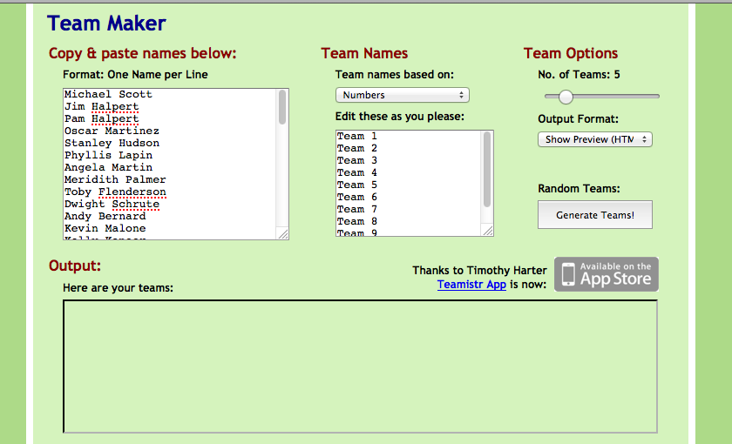
Working collaboratively
http://chir.ag/projects/team-maker/ (Team Maker)

Slide 36
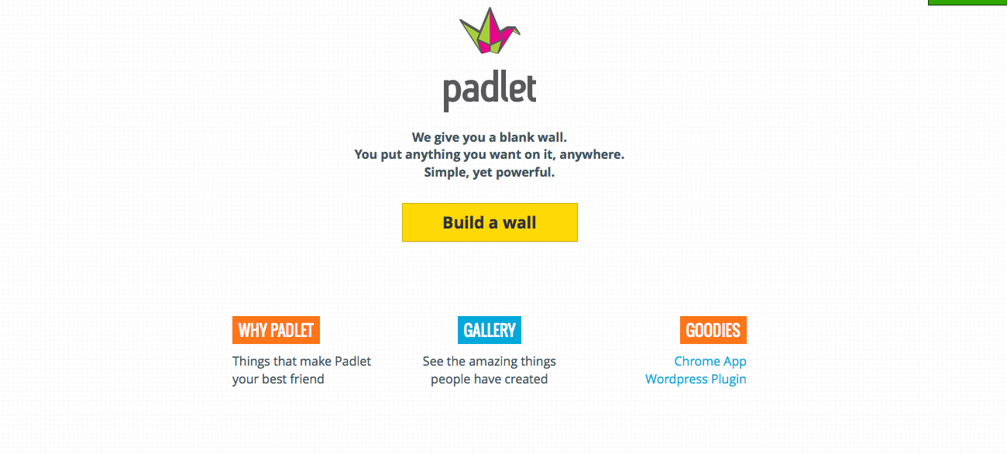
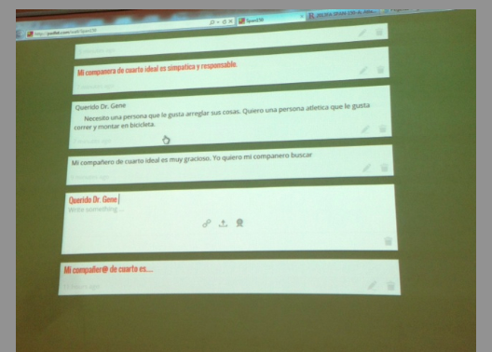
Working collaboratively
Padlet http://padlet.com/

Slide 37
Padlet
On your device go to the following website:
http://padlet.com/wall/FLAVA2013
Post your favorite website or app that you are using in your classroom.

Slide 38
Talkboard (iPad-iPad)

Slide 39
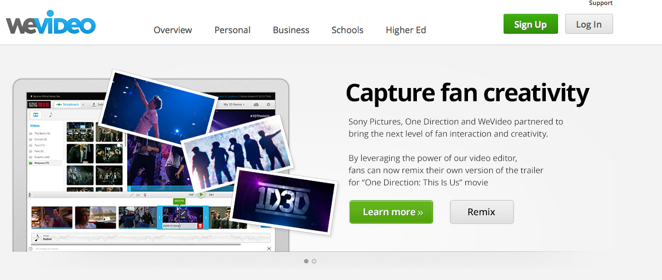
Working collaboratively
WeVideo. http://www.wevideo.com/ (Students can collaborate together to make a documentary) Free/$

Slide 40
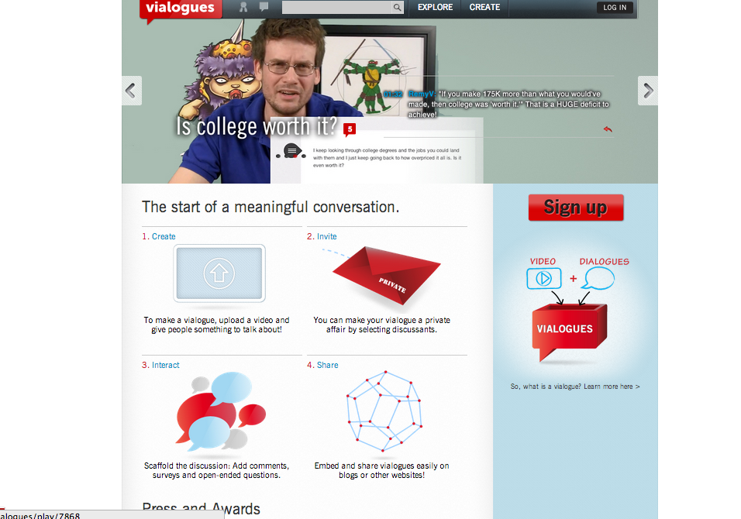
Watching a movie/video collaboratively
Vialogues https://vialogues.com/

Slide 41
Pinterest
http://pinterest.com/ (Writing and Speaking Prompts)
http://pinterest.com/miscositaspix/speaking-writing-prompts/

Slide 42
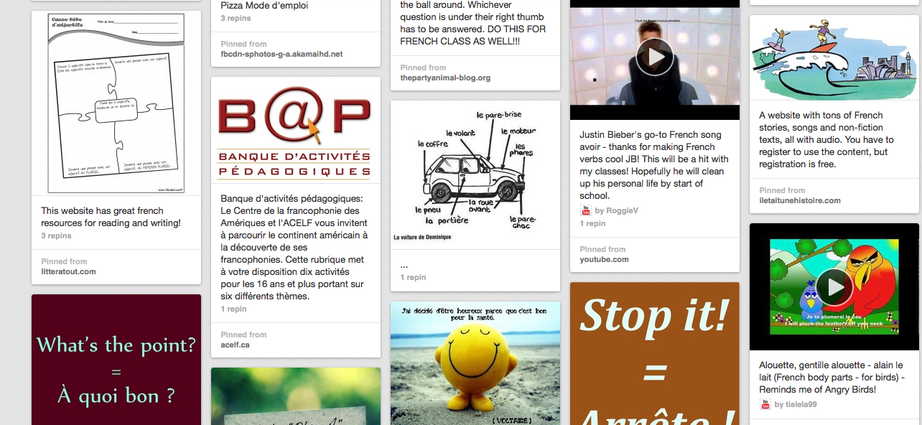
Pinterest board from Lynn McCrady (VA French teacher)
http://pinterest.com/myhnylynn/la-classe-de-francais/

Slide 43
EVEN MORE RESOURCES!
https://groups.diigo.com/group/calicotools
http://cooltoolsforschools.wikispaces.com/home
http://www.boxoftricks.net/internet-resouces-for-education/

Slide 44
Next Steps
What did you learn that is new?
What are you ready to try with your students? What is your tech plan for this grading period or for this year?

Slide 45
Questions and Comments
Do you have any questions about today’s presentation?
Do you have a favorite Tech Tool that you have used in your class?
Made using the Keep Calm App

Slide 46
How to contact me:
Christine S. Stanley Roanoke College Department of Modern Languages 108 Lucas Hall 540-375-5296 cstanley@roanoke.edu
Notes:
Giuliana

Slide 47
Online Session Evaluation (SESSION 72) Engage and Educate with Tech Tools Christine Seeber Stanley

