Slide 1
Commercial Card
Expense Reporting (CCER)
The Trustees of Roanoke College
An internet solution
Accessed via Wells Fargo’s secure Commercial Electronic Office® (CEO) portal

Slide 2
Commercial Card Expense Reporting (CCER)
What is it?
CCER is an internet reporting solution that allows on-line access to your card transactions at any time, from any location. It is accessed via Wells Fargo’s secure Commercial Electronic Office® (CEO®) portal.
Cardholders can:
Review/reclassify transactions
Input a business description for all transactions
Split transactions
Approvers can:
Review/approve cardholder statements
View statement summary reports

Slide 3
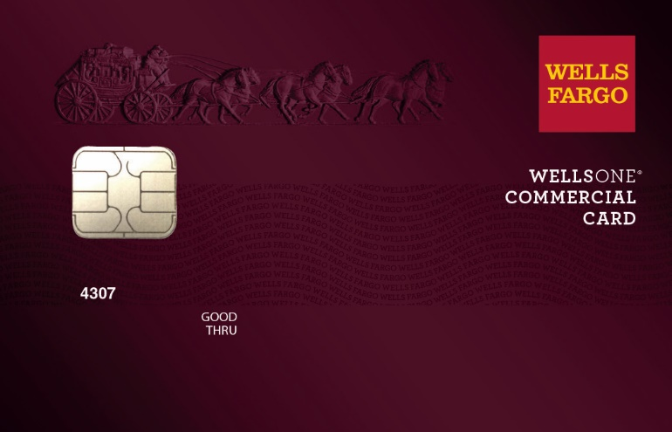
To get started
After receiving your card…
Activate your card by calling the toll free number located on the activation sticker
During activation you will need your Unique Identification Number (ID) - if you do not know your Unique ID, please contact your internal Program Administrator to obtain
During activation you will be asked to create a customized Personal Identification Number (PIN)
Sign the back of your card
Record the Wells Fargo Customer Service number (1-800-932-0036) located on the back of your card in your mobile device, or address book
Sign on to the CEO and initialize your CEO User ID

Slide 4
Chip and PIN Card Information
To enhance the security of your credit card purchases, your new commercial card features chip and personal identification number (PIN) technology, in addition to a magnetic stripe. With this card, you will have added identity verification and more flexibility at chip-enabled and traditional magnetic stripe terminals. Please review the important information below to help you get started with your new card.
About chip-enabled cards
  Over the next year, U.S. merchants will begin using terminals that accept chip-enabled credit cards. Until then, you may use your card by swiping at the point of sale, just as you do today.
  As chip-enabled terminals are already being used internationally, you may use your card to complete chip-enabled transactions in Europe, Asia, South America, and Canada.
Getting started with your new card
To activate your card, you will need your unique identification (ID) number. If you do not know your unique ID, please contact your program administrator.
Activate your new card immediately by calling 1-800-932-0036, 24 hours a day, 7 days a week.
  When dialing from outside the U.S. or Canada, dial 001-800-932-0036. This is not a toll-free number when calling internationally.
  If you need help internationally, please call customer service collect at 1-612-332-2224.
When you activate your card, you will select a personal identification number (PIN). Use this PIN for chip-enabled transactions when prompted by the terminal. This same PIN will be used for cash advances, if you are authorized to make them. Depending on the terminal set-up, you may be prompted to provide your signature instead of your PIN. Once activated, the card is ready for use at either mag stripe terminals or chip enabled terminals.
If you forget or need to change your PIN, call the WellsOne Service Center at 1-800-932-0036, option 2, option 1.2.

Slide 5
New User Sign On
Sequence of steps
Sign on to the Commercial Electronic Office® (CEO®) using your temporary password
Change your password
Set up your secret questions
Read and accept the CEO Terms of Use
Confirm your profile information
Notes:
If you will be using an RSA SecurID® token device, we'll cover that topic after the first-time sign-on steps.
We'll begin with how to access the CEO portal itself…

Slide 6
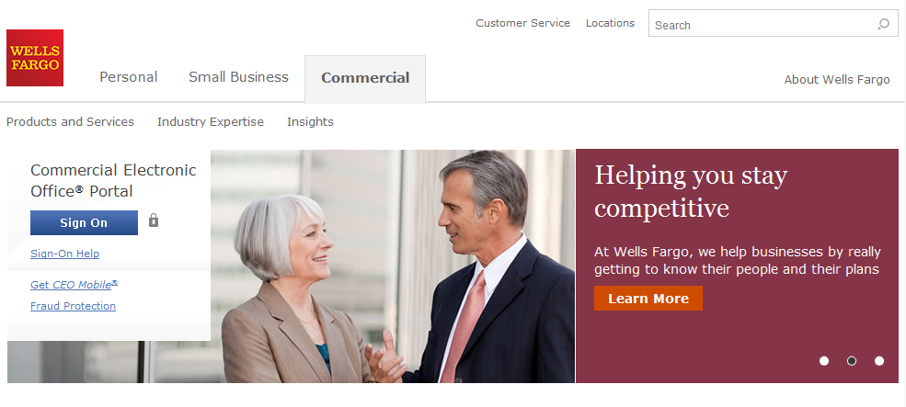
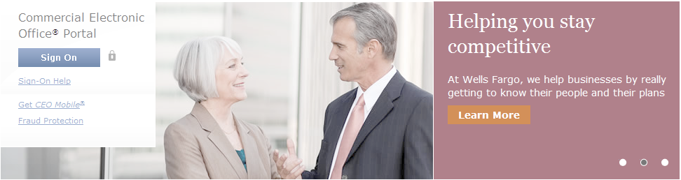
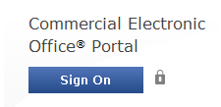
Wells Fargo home page wellsfargo.com

Slide 7
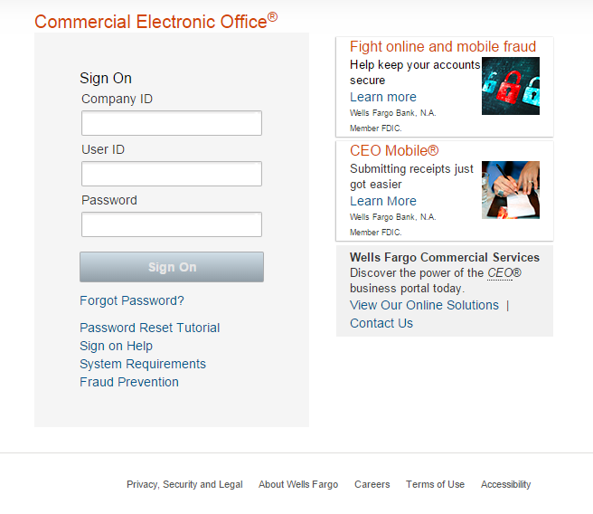
CEO portal sign-on website https://wellsoffice.wellsfargo.com
Enter your:
Company ID
  TRUST898
User ID
  Unique to user
Password
  Unique to User
Company ID, User ID and Password
are not case sensitive
To change or reset your password, click the Forgot Password? link.
If you incorrectly enter your password twice in the same session, you will automatically be taken to the Change Your Password page.

Slide 8
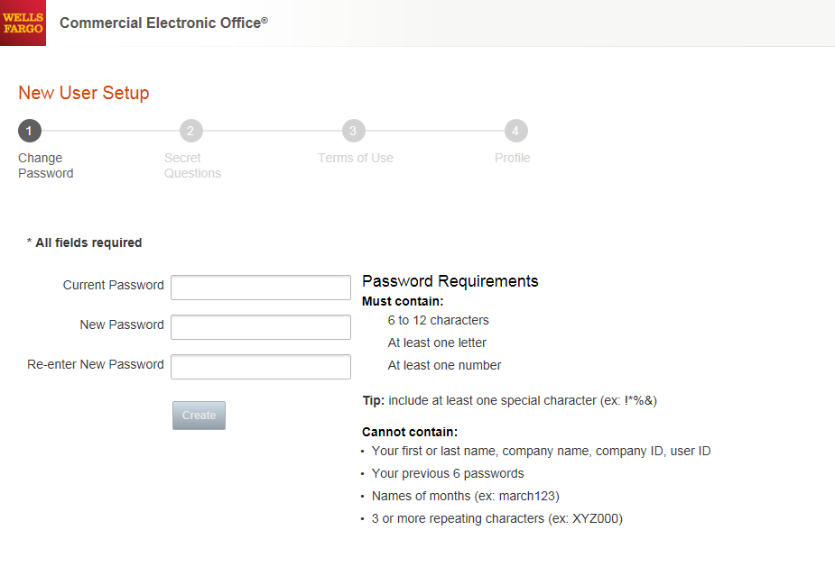
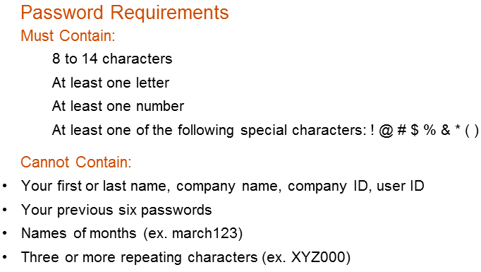

Change your password
●●●●●●●●●
●●●●●●●●
●●●●●●●●

Slide 9
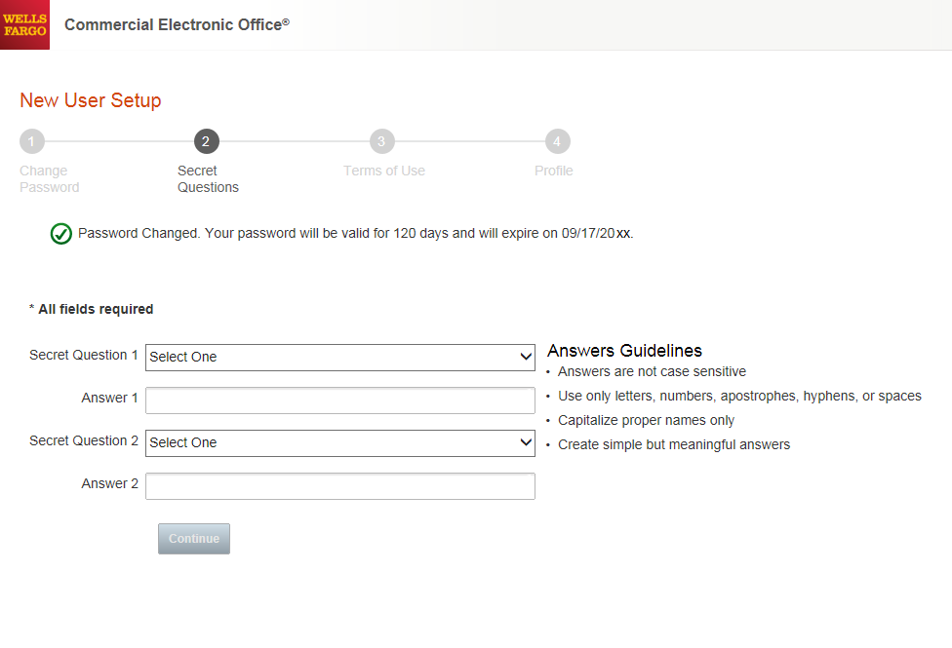
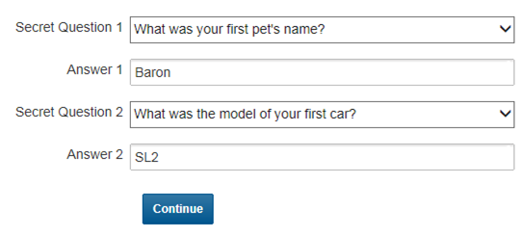
Set up your secret questions

Slide 10
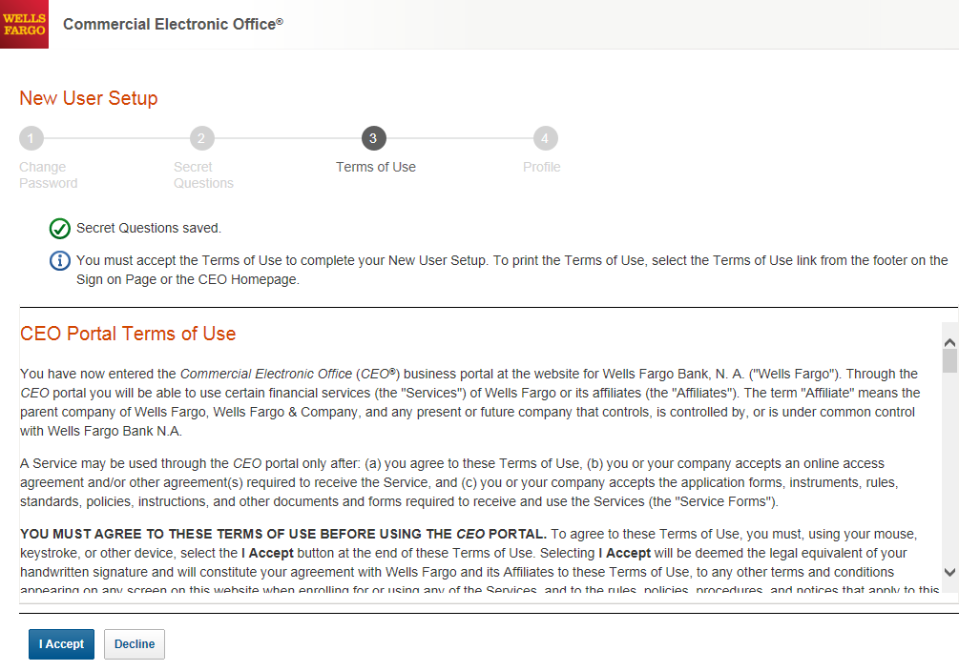
Read and accept the CEO Terms of Use

Slide 11
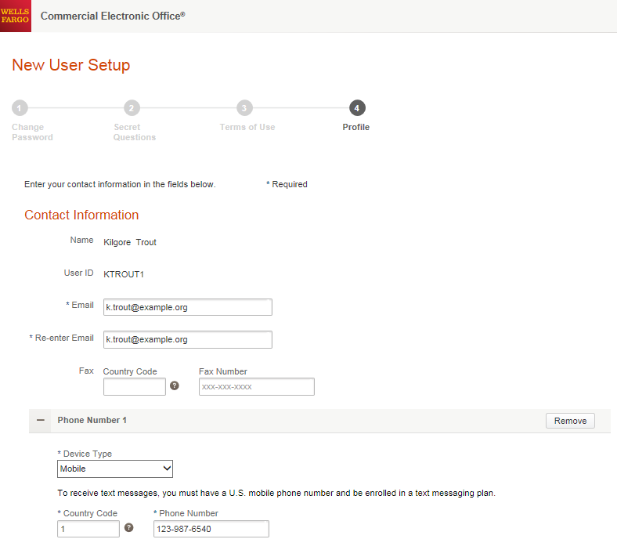
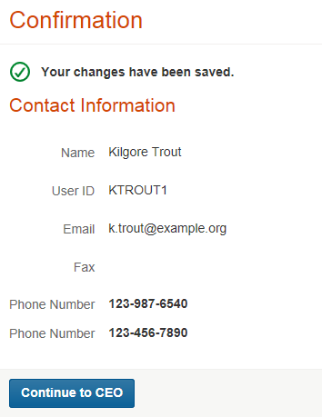

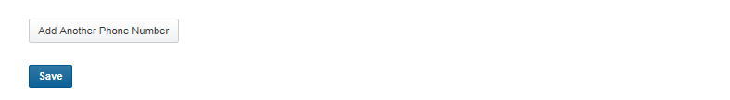
Confirm your profile Contact Information
Enter your email and phone information; Save, then Continue…

Slide 12
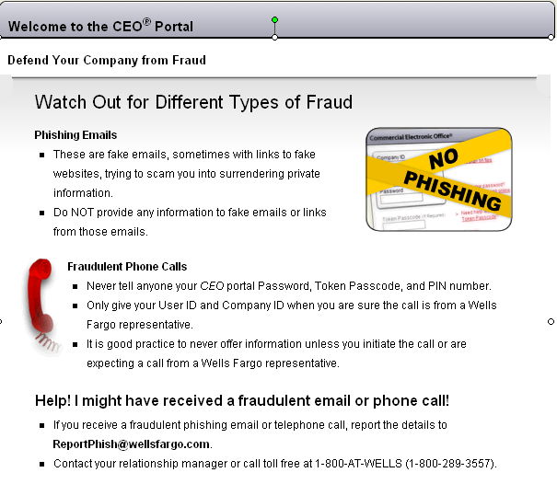

Slide 13
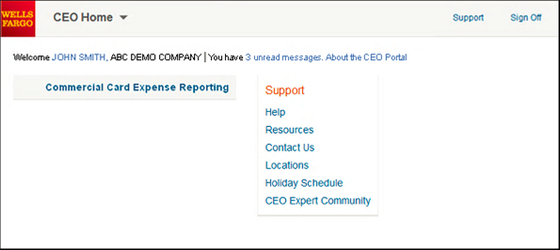
CEO home page
Click the link for Commercial Card Expense Reporting. A separate browser window opens and displays the CCER service
Click on Support to register for free online CEO product training
Click on Help for assistance and training
To automatically display CCER when you sign on to the CEO portal, click the link for your user name to set up Automatic Access
On the profile page, click the Edit link under Preferences
Set Automatic Access to the desired setting and click Save

Slide 14
Cardholder experience

Slide 15
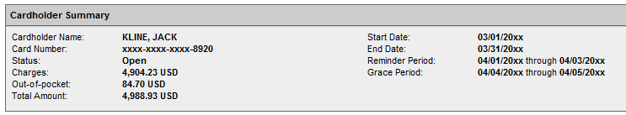
Cardholder review period
Review your company’s unique CCER statement cycle, and Reminder and Grace Periods within the Cardholder Summary located at the top of the Review Open Statements and View Cycle-to-Date screens
An email will be sent out to Cardholders (and Reconcilers) when the current statement cycle has ended, indicating that the statement can be submitted for approval (Statement Reviewed). If the statement end date falls on a weekend, the email will be sent the following Tuesday.
If the Cardholder (or Reconciler) has not reviewed and submitted the statement after 3 calendar days, a reminder email will be sent out. Cardholders and Reconcilers will have an additional 2 days grace to complete the review.
If you are on vacation or do not have online access, contact your Program Administrator.

Slide 16
E-Mail notification
Cardholder statement ready for review
Statement review for 05/31/20XX
Dear Cardholder:
Your most recent statement is ready for review by accessing the Wells Fargo Commercial Card Expense Reporting system for the following card(s):
xxxx-xxxx-xxxx-1234
Please complete your review in a timely manner and forward your receipts as appropriate.
This is an automated email. Please do not reply to this message.

Slide 17
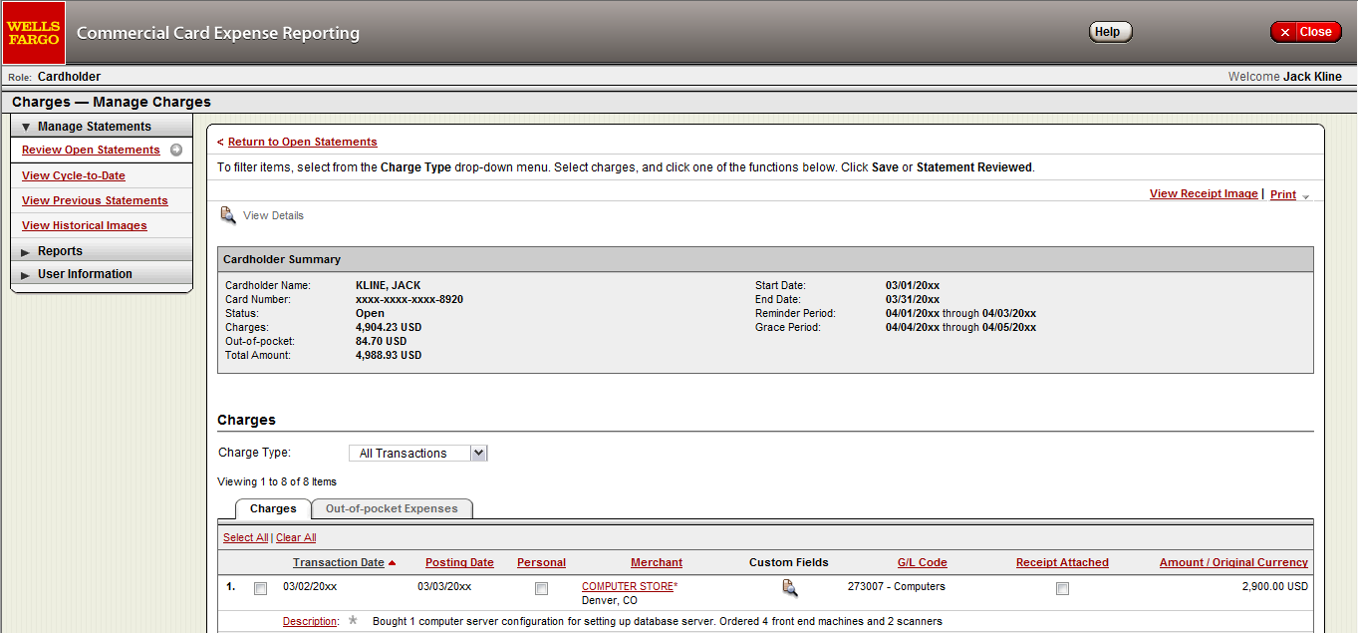
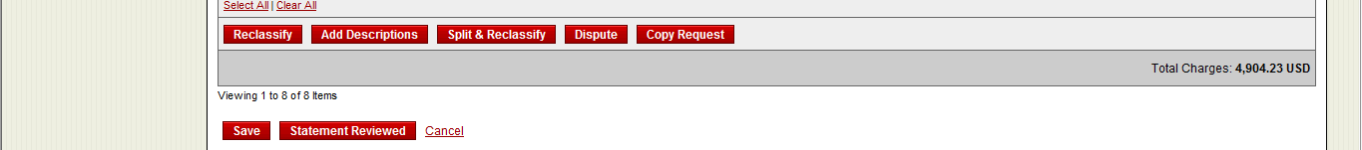
Cardholder home page
Manage Statements – Review Open Statements
The Statement Reviewed button (which submits the expense report to the Approver) will only be available in Review Open Statements
  Review open statements (default screen for cardholders) will become available when your company has reached the statement End Date
  Finalize the statement during the review period

Slide 18
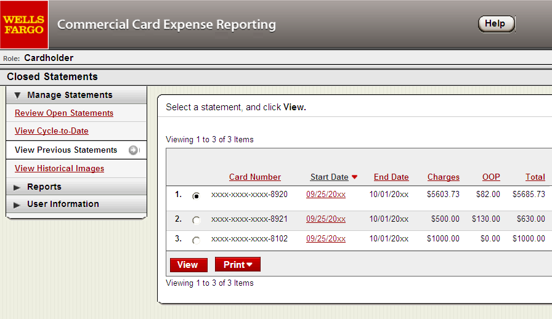
Manage Statements
View Previous Statements – 13 month history

Slide 19
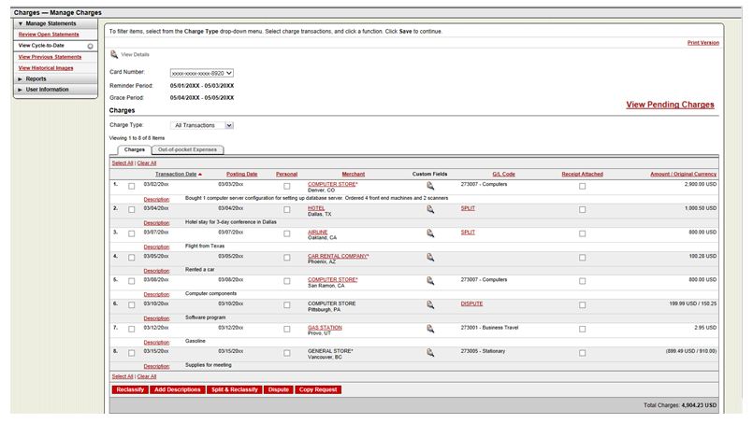
Manage Statements
View Cycle-to-Date Transactions
  Transactions appear on your statement as they are posted through the system
  To view Real-Time Authorizations, click on the View Pending Charges link

Slide 20
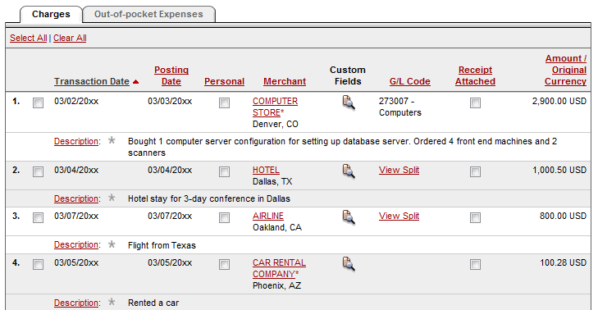
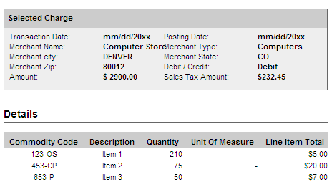
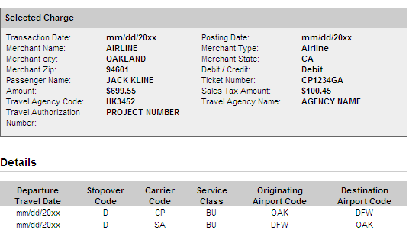
If a vendor transmits
additional details with
the transaction, the
merchant name is
red and underlined
Select the merchant name to access the detail screen

Slide 21
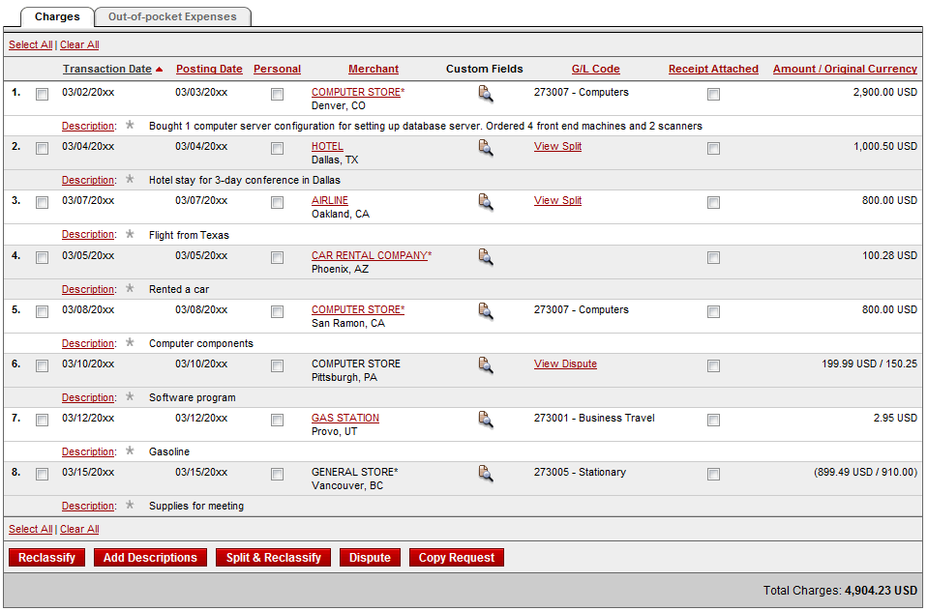
Available functionality includes:
  Reclassify - allocate an entire transaction and add a description
  Add Descriptions - provide transaction details
  Split and Reclassify - divide a transaction multiple ways and add descriptions
  Dispute - dispute a transaction

Slide 22
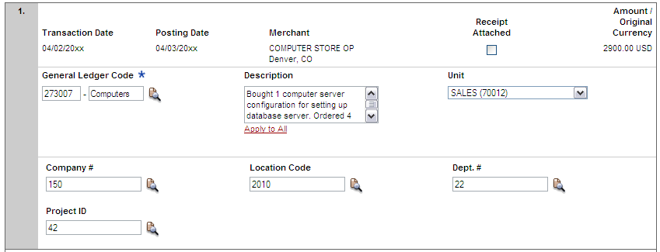


Reclassify screen
Click the icon to reclassify the general ledger code
Enter a business description
Click the icon(s) to choose values to allocate the transaction
  Avoid special characters - < > % ; ( ) & + \ # ? { } I ^ ~ [ ] “ ‘
  Please note the system will timeout after 15 minutes of inactivity. You will receive a warning message shortly before the session is set to expire.

Slide 23
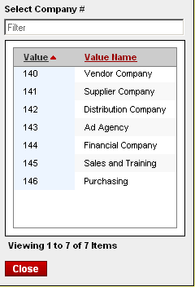
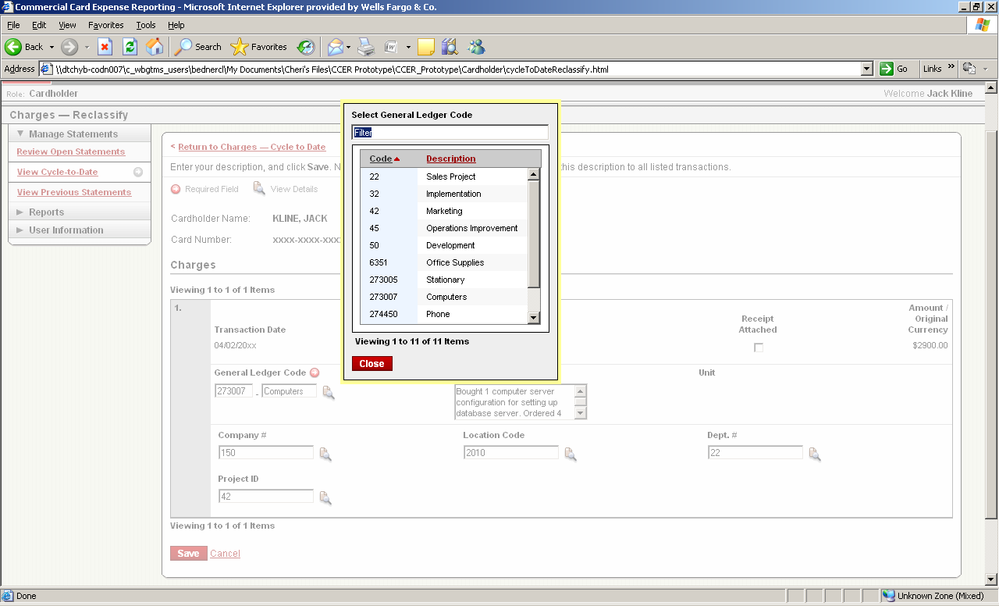
Reclassify screen

Slide 24
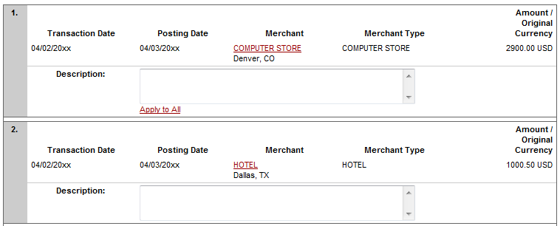

  Add description screen
  Add a transaction description (can be up to 200 characters)
  Click the Apply to All link to apply the same description to all selected charges
  Provide name of guests entertained (if applicable)
  Adhere to company policy
  Avoid special characters - < > % ; ( ) & + \ # ? { } I ^ ~ [ ] “ ‘

Slide 25
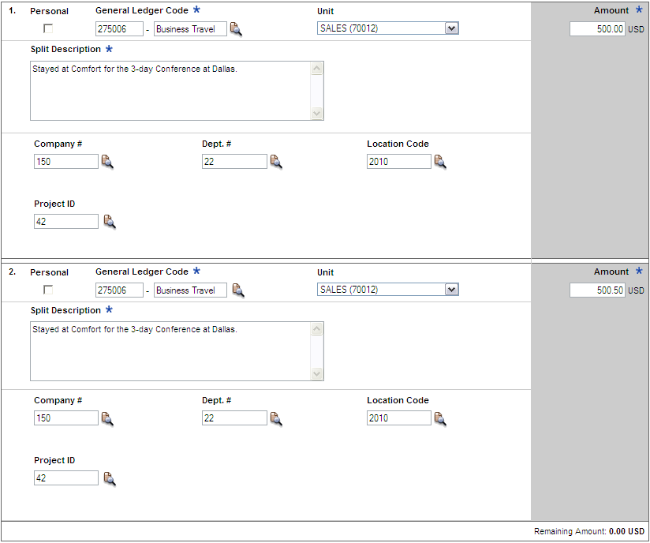

Split and reclassify screen
  Divide and reallocate a transaction into multiple entries
  Split by amount or by percentage
  Select add to create a new row and begin the split process

Slide 26
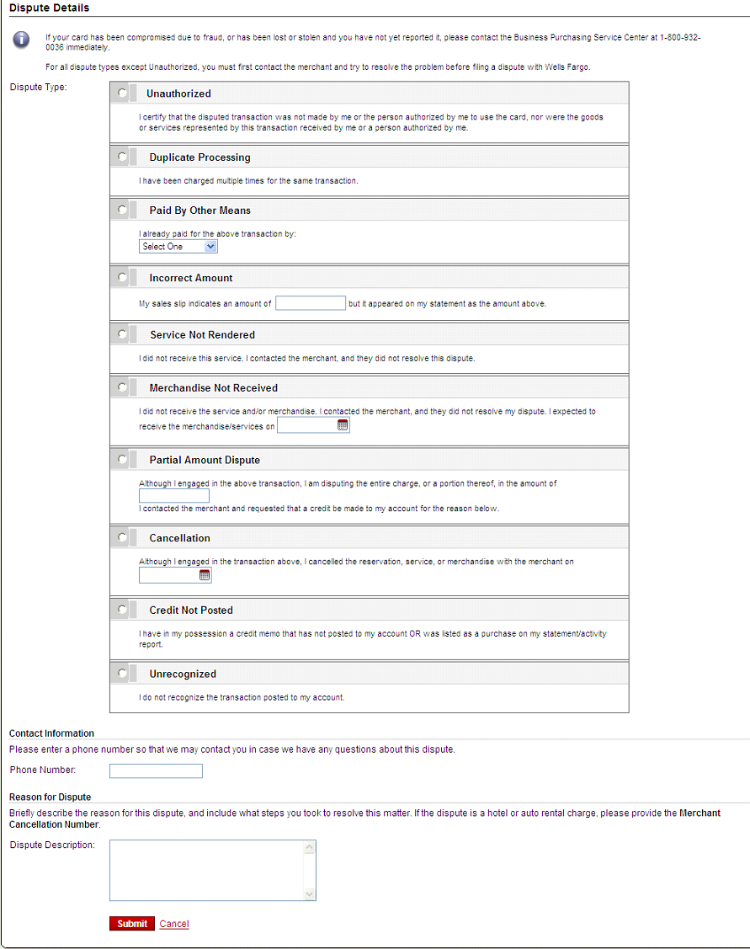
Dispute transaction screen
Contact the vendor FIRST to try and get a refund or correction
If unresolved after working directly with the vendor, complete the online (or paper) form
Notify program administrator of dispute
You have 60 days from the posting date to dispute a transaction
Additional supporting information may be requested
Call the service center if there are unrecognized transactions or suspected fraud

Slide 27


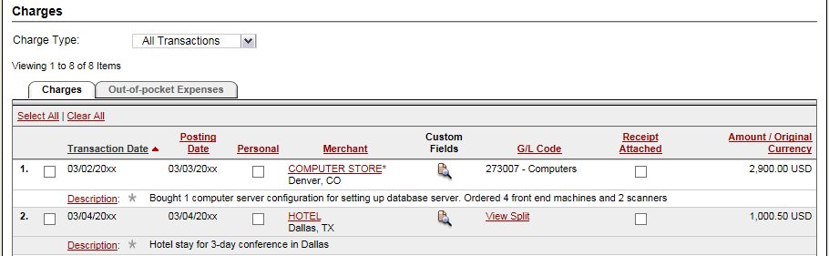
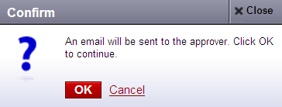
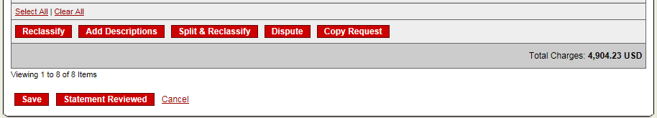
Complete your review
Select statement reviewed and a message box appears indicating that an email will be sent to your approver
Select cover sheet option on the “print” drop-down menu to print the cover sheet for this statement. Email or fax in receipts with the coversheet, or upload receipts via CEO Mobile

Slide 28
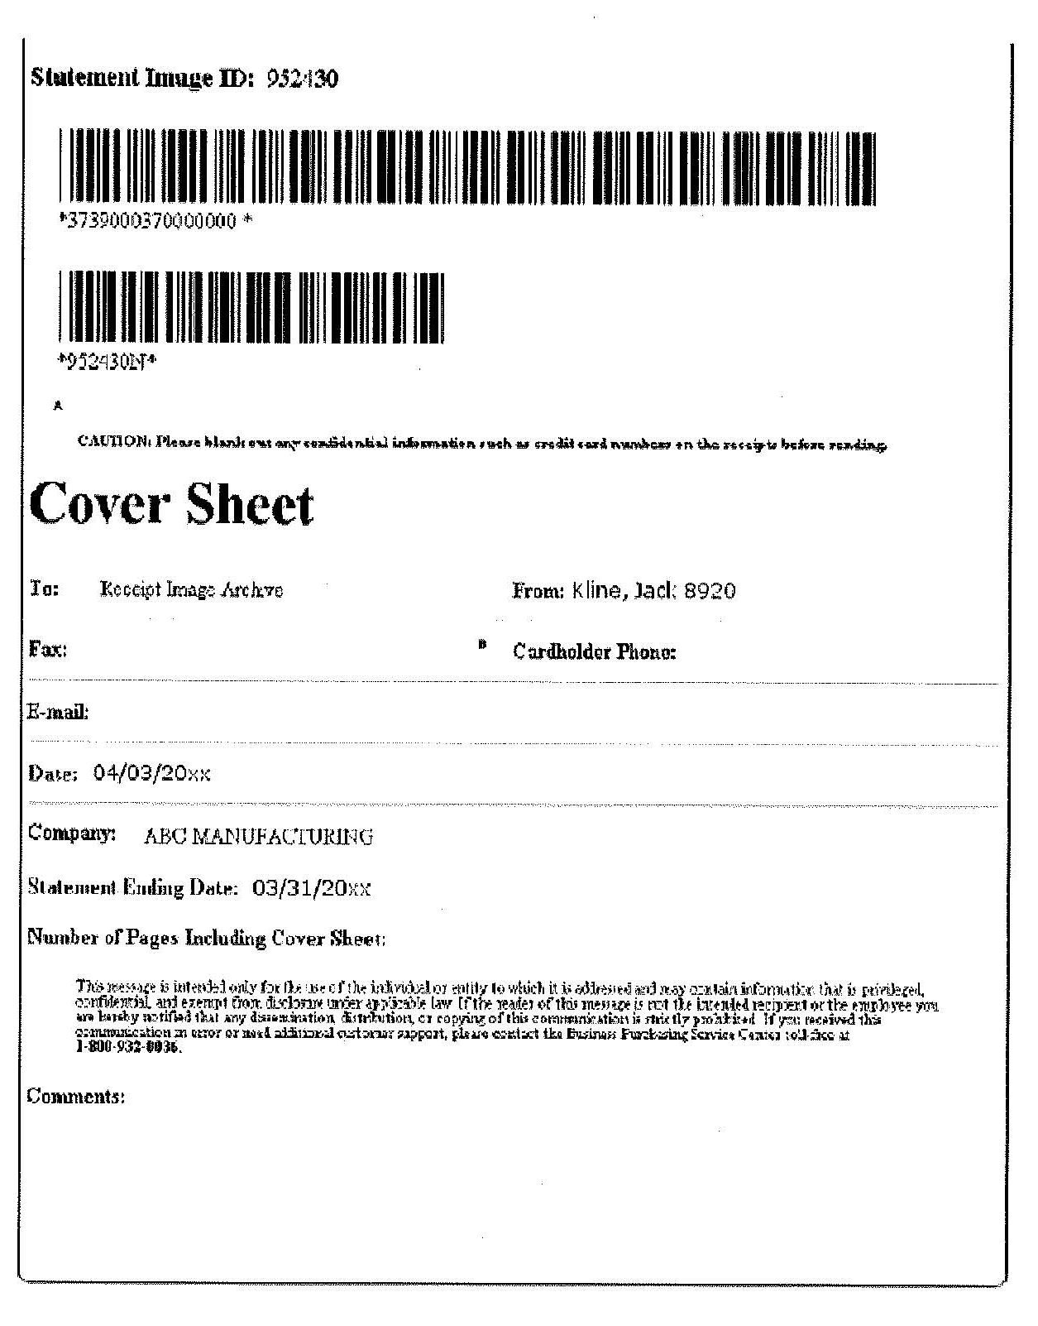
Receipt Imaging Cover Sheet
Receipts may be submitted in one of three ways:
1. Email
User emails a single PDF containing the
cover sheet at the beginning followed by the
receipts for that statement period, or the
User emails a set of attachments containing
images in any of the following types and
includes the cover sheet as one of the
attachments (PDF, JPG, GIF, TIF, PNG, BMP)
Fax
Fax the cover sheet and receipts for the
statement period to the 800 number
provided
CEO Mobile Application
Users may select which statement to upload
(the two most recent statements periods
will be available), or click the upload receipts link
directly, and then select the statement
  Email Best Practices:
  Make sure attachments are sent in one of the 6 accepted file types.
  Make sure the bar codes on the cover sheet are clear and easy to read.
  Do not include email signature lines or logos
  Emails configured in plain text format have a better success rate.
  A maximum of 5MB per file attachment is recommended. The maximum allowable size for an email and all attachments is 25MB.
866-xxx-xxxx
wf_ccard_receipts@mail2image.com
Make sure the cover sheet pertains to the correct statement period.
Receipts may be submitted in batches throughout the statement cycle, or in one batch at the end of the statement review process

Slide 29
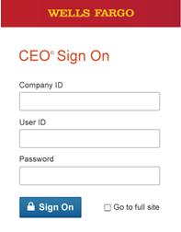
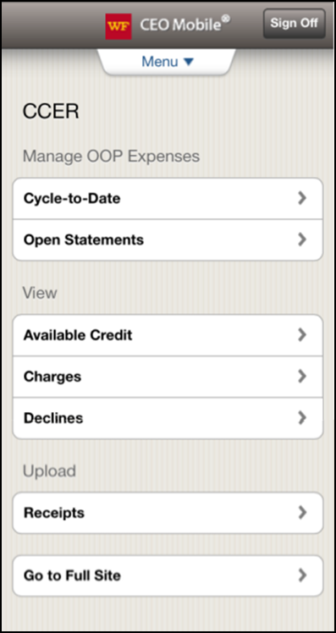
CCER access via CEO Mobile
CEO Mobile Service
  Access via the browser on your mobile device using your Company ID, User ID and Password at: https://ceomobile.wellsfargo.com
  Download the CEO Mobile iPhone app from the Apple App Store at https://itunes.apple.com/us/app/wells-fargo-ceo-mobile/id335685323?mt=8
  Download the CEO Mobile Android app from the Google Play Store at https://play.google.com/store/search?q=Wells%20Fargo
    This link only works when viewed on an Android device
  An online video can be viewed at: http://wholesale.wellsfargobank.com/ceomobile_card-management
Cardholders can:
  Add/edit out-of-pocket expenses
  View available credit
  View posted card charges
  View declines
  Upload receipts
OOP Only Users can:
  Add/edit out-of-pocket expenses
  Upload receipts

Slide 30
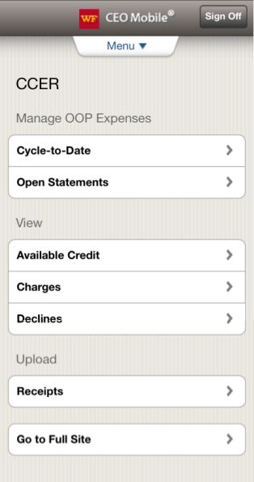
Mobile Receipt Imaging
Getting started
Start the upload process
  Select which statement to upload into, and then tap Receipts under the Upload section
  Or tap Receipts directly, and then select the statement
The two most recent statement periods will be available for selection

Slide 31
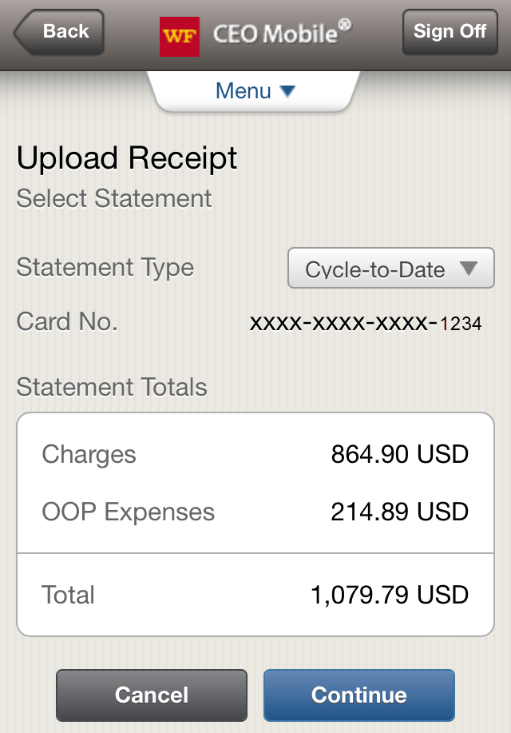
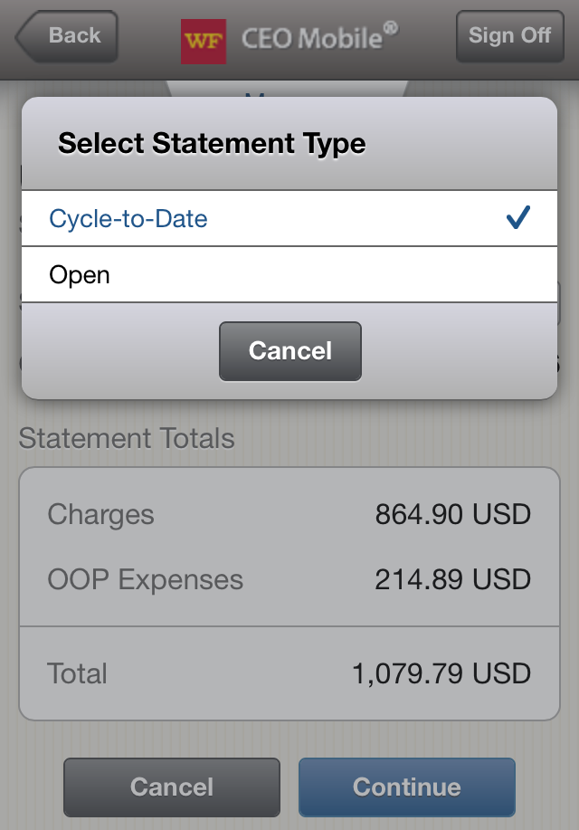
Mobile Receipt Imaging
Statement Type
The Cycle-to-Date statement is selected by default
You may tap the Statement Type drop-down menu and change to the Open statement period (tap Continue)

Slide 32
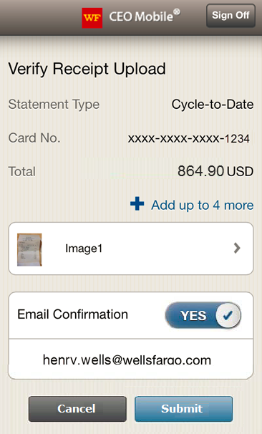
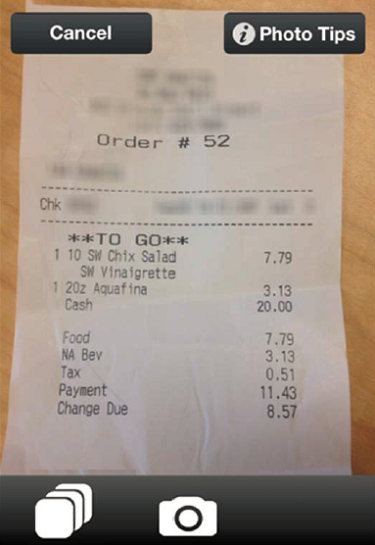
Mobile Receipt Imaging
Take a photo, or select receipt images from the gallery
After selecting Continue, hold the camera over the receipt and tap the camera icon to take a photo (there will be an option to Use or Retake the image)
Tap the photo gallery icon to upload up to 5 images from the photo gallery (select Done when finished)
On the Verify Receipt Upload page, tap the + Add link to upload additional images
Slide the Email Confirmation to YES to receive an email confirming the action taken (this does not guarantee the receipts will be successfully processed)
Tap Submit when finished

Slide 33
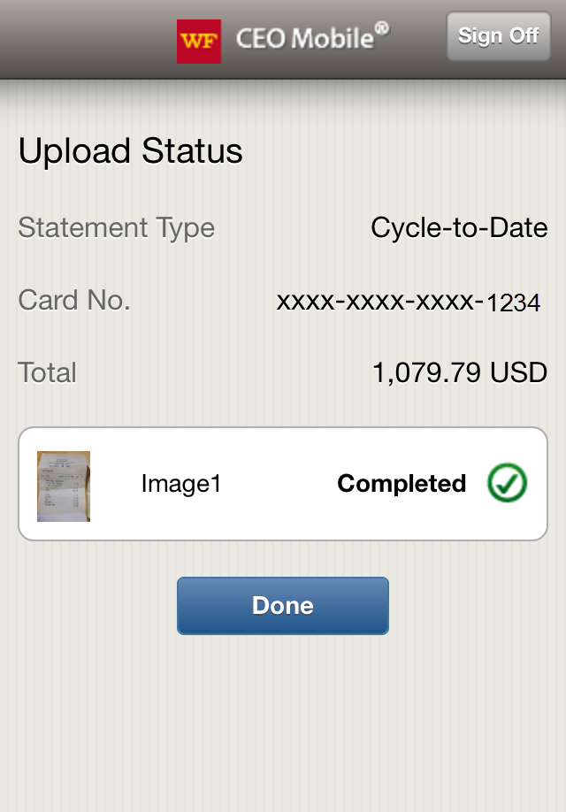
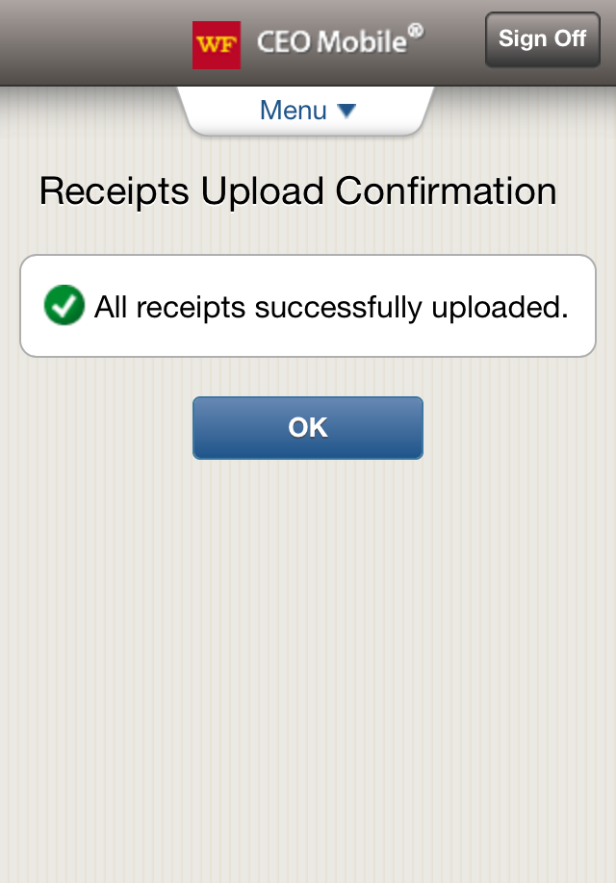
Mobile Receipt Imaging
Confirmation and processing
A confirmation page will confirm that images were successfully uploaded (tap Done, then OK)
  This again does not guarantee the images will be successfully processed
  An email will be sent to you noting any image upload failures

Slide 34
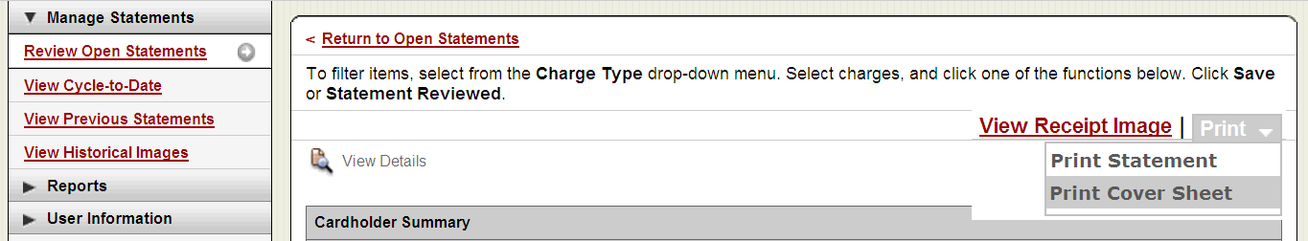
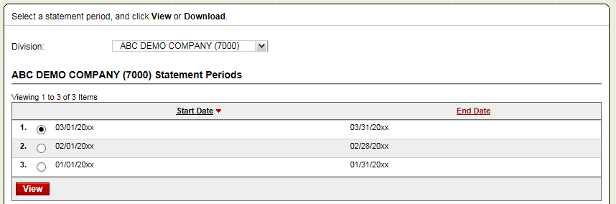
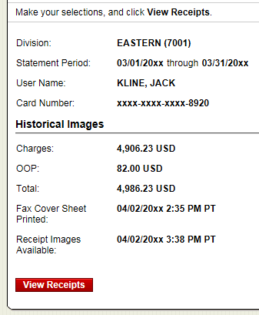
Receipt Imaging
Viewing Images
View images by clicking the “view receipt images” link found on the open statements, cycle-to-date, and previous statement screens
Print cover sheets for prior statements on the view previous statement screen
View historical images for up to seven years via “view historical images”
Select statement period and click view, then click view receipts

Slide 35
CCER access via CEO Mobile
CEO Mobile Service
  Access via the browser on your mobile device using your Company ID, User ID and Password at: https://ceomobile.wellsfargo.com
  Download the CEO Mobile iPhone app from the Apple App Store at https://itunes.apple.com/us/app/wells-fargo-ceo-mobile/id335685323?mt=8
  Download the CEO Mobile Android app from the Google Play Store at https://play.google.com/store/search?q=Wells%20Fargo
    This link only works when viewed on an Android device
  An online video can be viewed at: http://wholesale.wellsfargobank.com/ceomobile_card-management
Cardholders can:
  View available credit
  View posted card charges
  View declines

Slide 36
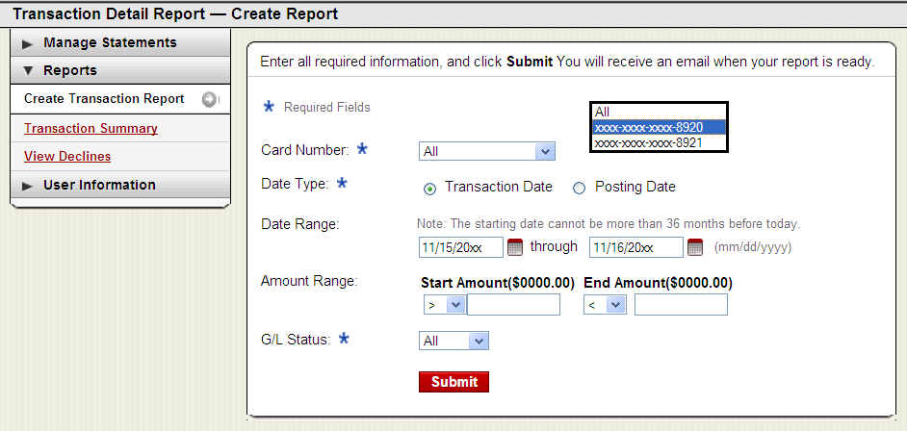
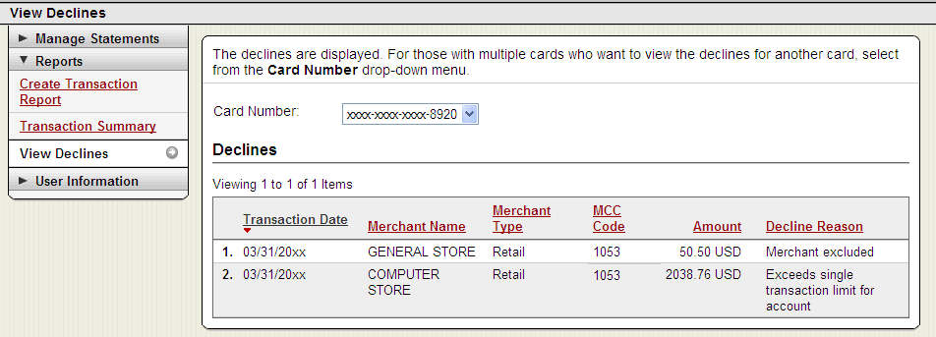
Reports
Run transaction reports with various filters
You are notified via e-mail when the report is ready
View declined transactions to determine the reason for the decline
Declines do not appear in real time, they will be displayed within 48 hours

Slide 37
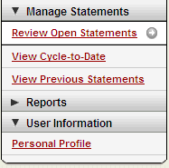
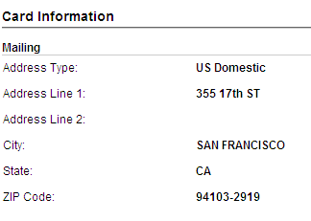

Personal profile
Click on link to Manage Alerts
Billing address for online and phone orders
You can also contact the
WellsOne Service Center 24/7 at
1-800-932-0036 to obtain available credit.
Must provide Unique ID to
obtain any information
Click to retrieve current available credit

Slide 38

Commercial Card Account Services
Manage Alerts (offered for purchases and available credit)
A Purchase Threshold is required for general Purchase alerts (alerts are sent when this threshold is exceeded)
Online Purchase alerts are issued on all online card activity
The Available Credit alert is requested by texting “Avail” to 93236 (amount of available credit is be received back via selected delivery channels)
During first time enrollment, if alerts are set to “by Text”, you will receive an Opt-In text message on your mobile device (reply “YES” or “START”)
Email alerts do not have an opt-in process so they will begin immediately

Slide 39
3D Secure – Verified by Visa /
MasterCard SecureCode
What is 3-D Secure:
3-D Secure is the industry name for Verified by Visa and MasterCard SecureCode.
3-D Secure technology secures online transactions using an additional level of cardholder authentication.
With the introduction of Chip and PIN cards, fraud is increasingly moving online. International and now U.S. internet merchants are beginning to require 3-D Secure to complete transactions.
How it works:
  Cardholders must register their cards online prior to completing their purchase at a 3-D Secure enabled merchant.
  As part of the registration process, you will need to provide correct answers to 3 identity authentication questions. You will then create a personal passcode to be used for future purchases.
  Once enrolled, you will be prompted to input your personal passcode during the checkout process at 3-D Secure enabled merchants.
How to Enroll:
In order to enroll in this free, online security service, cardholders must:
  Register their card at:
  https://www.wellsfargo.com/com/fraud/payments_fraud/online-purchase-protection. During the registration process you will be asked to provide the last 4 digits of your Unique ID, your monthly credit limit, and the zip code tied to your card to verify your identity (all information may be found in your personal profile). Once this has been provided, you will create a personal passcode to be used when making online purchases with participating merchants.

Slide 40
Cardholder Responsibility
Collect receipts to verify purchases for auditing
Watch for unauthorized transactions on your statement and report/dispute them immediately
Dispute any incorrect charges with the vendor directly before filing an online or paper dispute form
Complete your reconciliation by the due date
Keep the card (and card number) confidential

Slide 41
Contact information
WellsOne Service Center - 1-800-932-0036
  From outside of the United States call 1-612-332-2224
  Call immediately if your card is lost, stolen or suspected missing
  For immediate decline information
  To access the automated voice response system for the following information:
    Current balance
    Available credit
    Reset PIN
Contact a program administrator if:
  You have questions about your card
  Need to increase your credit limit
  Change jobs
  Need to order cards for other employees
Program Administrators:
Kristen Douglas
Rachael Freeman
Rhonda Hibbitts
Adam Neal
Kathryn Vanness

Slide 42
Thank you!
© 2016 Wells Fargo Bank, N.A. All rights reserved. Confidential.

